Slide 1
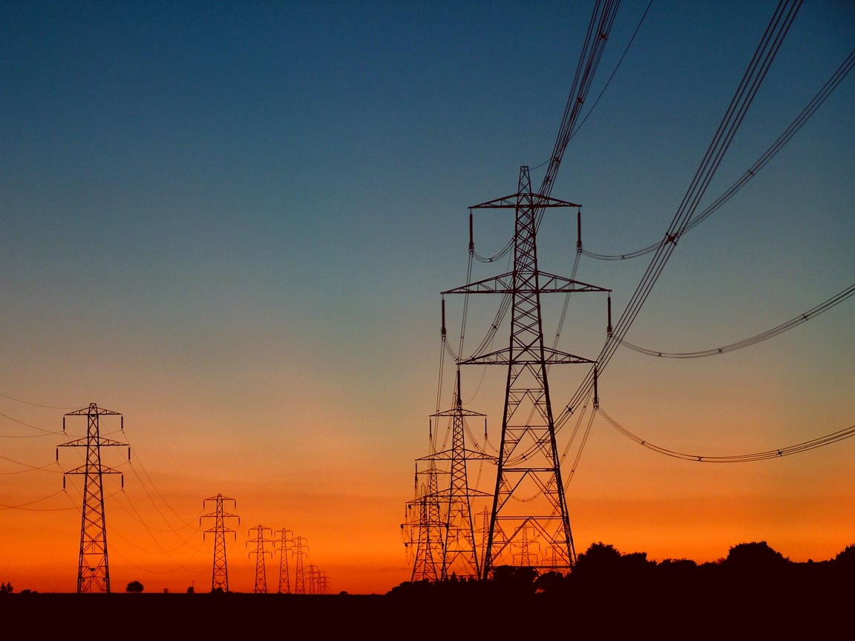
Electric Utility/Line worker
Ben Castle

Slide 2

LCC
Lansing Community College has had this class since fall of 2010. Since electrical work is something I can cope with since my father was one, I know some stuff that he had taught me.

Slide 3
Things To Do
Line workers install and service power lines and power line connections between electrical power plants and the customer using the electricity. These lines may be above ground on utility poles or underground. This curriculum prepares students to enter the Line worker's Apprenticeship Program with Consumers Energy.

Slide 4
Salary
It’s a certificate instead of a associates. Starting pay is $24/hr, which is equivalent to $48,000 a year. You work the regular 40 or so hours s week, depending on the situation that persists. Afterwards, you can work up to $31/hr. Which is equivalent to $62,000 a year.

Slide 5
Courses
REQUIREMENTS TOTAL: 33 CREDITS
CODE TITLE CREDIT HOURS
ELTE 102 Industrial/Construction Safety (See Note 1) 2
ELTE 110 Practical Electricity (See Note 1) 3
ELTE 131 Machine Controls I 4
ELTE 270 Lineman Orientation (See Notes 2 and 3) 1
ELTE 272 Electric Basic Line Climbing (See Notes 2 and 4) 7
ELTE 274 Ground/Utility Worker (See Notes 2 and 4) 7
METD 150 Industrial Blueprint Reading 3
METS 140 Rigging (See Note 1) 3
MGMT 290 TIME Series Topics (See Note 5) 1
PFFT 109 Introduction to Fitness 1
PFFT 113 Core Strength & Flexibility Training 1
MINIMUM TOTAL 33

Slide 6
The Job
I would be climbing up those big polls and placing electrical lines up real high, it helps that I’m not afraid of heights. Also underground work is part of it as well. Just because it’s underground doesn’t make it easier at all.

Slide 7
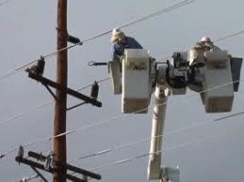
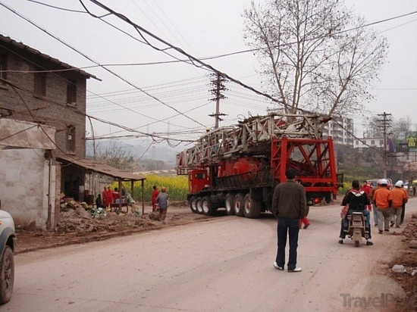
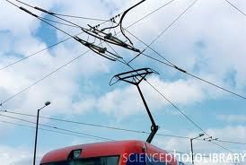
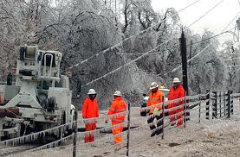
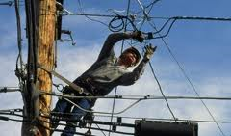
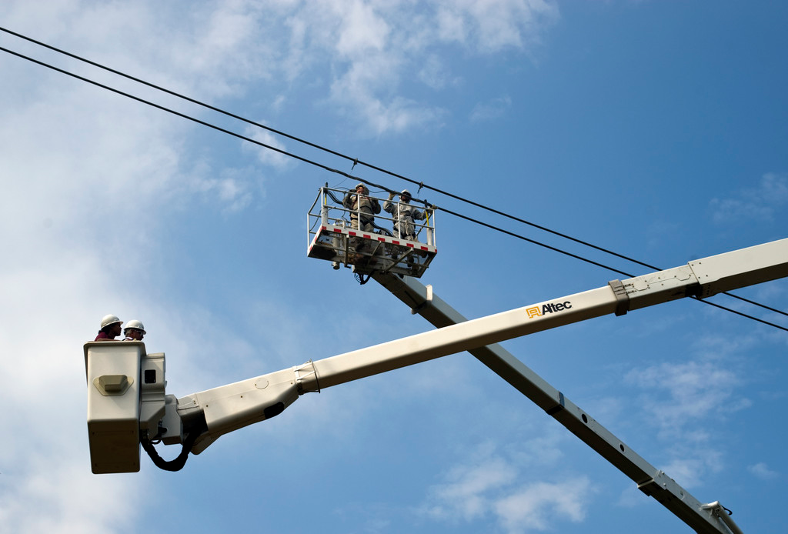
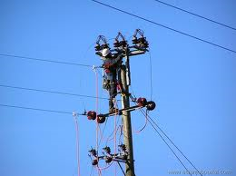
Pictures Of The Job

Slide 8
Maybe Scary
You are up so high in the sky balancing on a pole sometimes, and sometimes a belt around the pole. Helicopters are brought in at certain situations to fix power lines. It’s a long ways up, a long ways down. If your scared of heights, either get over it or find a new job.

Slide 9
Cost
I’m not sure how much many the certificate will cost, I’m think it’ll be around the average cost of most certificates. So figure that out and think of it around there somewhere.

Slide 10
Closing Statement
This job isn't for everybody. It’s not for the weak, or for the selfish. It takes team work to get the job done and concentration.

